Slide 1
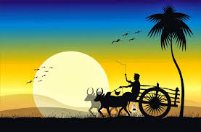
Welcome

Slide 2
Introduction
Md. Monirul Islam
Assistant Teacher ( English) Edgah Mult. High School & College Hathazari,Chittagong.
Mobile no: 01714851214
Email: m1214islam@gmail.com
Subject : English 1st paper
Class : 9-10 Lesson : 6,Unit-3 Title : Pahela Boishakh

Slide 3
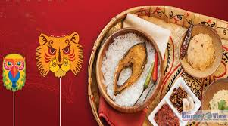
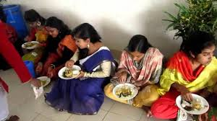
Look at the picture

Slide 4
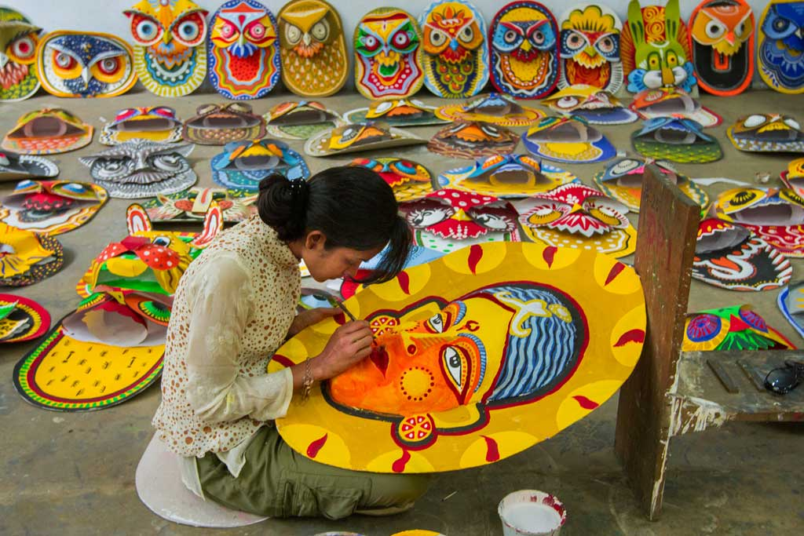
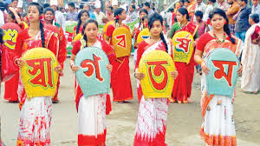
Look at the picture

Slide 5
Learning outcomes
After we have studied this lesson, we will be able to…
Read and understand texts.
ask and answer question .
Through silent reading.
Say some Word Meaning.
Write short compositions.

Slide 6
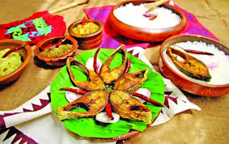
Pahela Boishakh

Slide 7
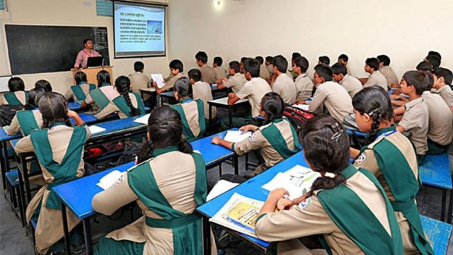
Reading the passage (Silent reading)

Slide 8
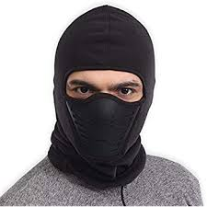
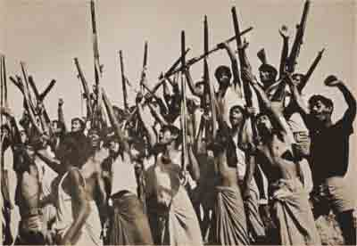
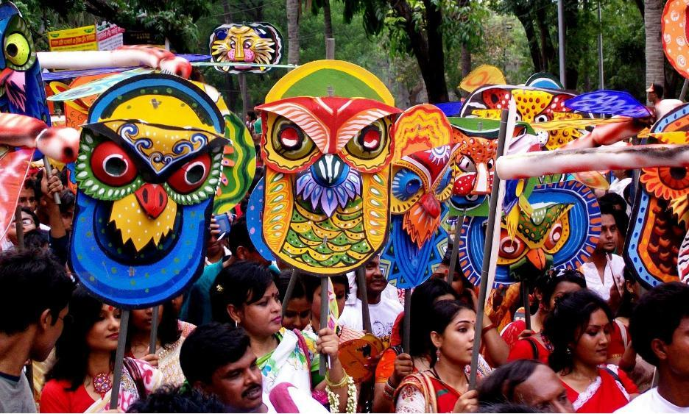
Word Meanings
Mask
Covering for the face
Procession
Number of people
Fascinating
Having great attraction

Slide 9
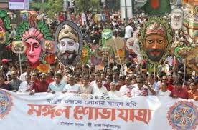
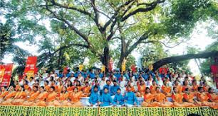
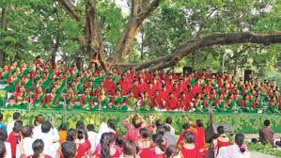
People also come to join the colourful processions, the biggest carnival of country , organized by the Fine Arts students of Dhaka University. The procession usually displays the traditional practices of Bangalee culture.

Slide 10
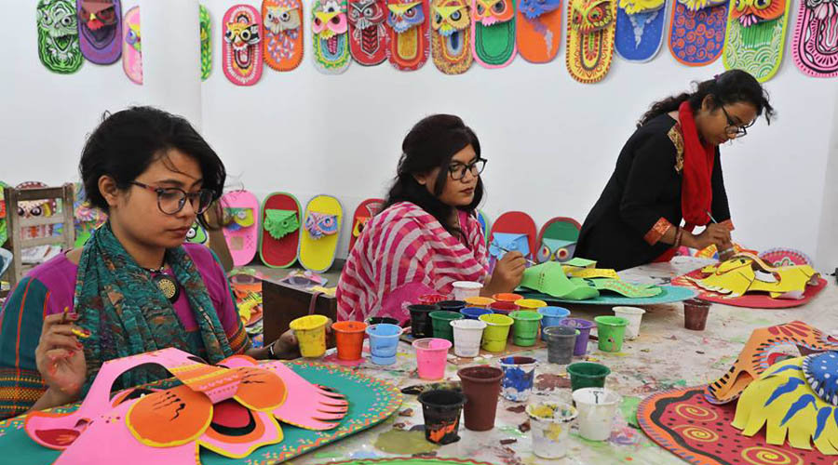
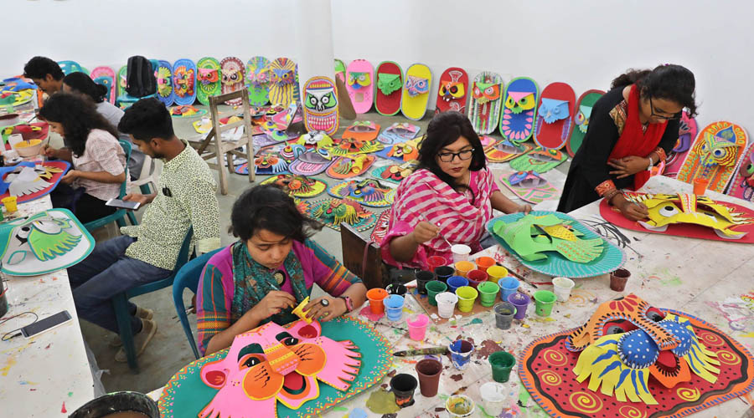
The celebration of Pahela Boishakh marks a day of cultureal unity for the whole nation irrespective of oaste and creed.

Slide 11
Individual Work
Answer the following questions
Why does Pahela Bishakh have a special significance for us?
What do the newspapers bring out?
What is the first month of Bangla year?
What does the day inspire people –to do?

Slide 12
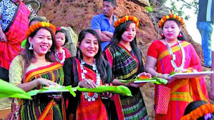
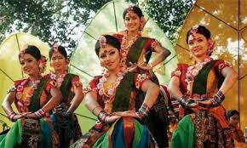
People from all walks of life, irrespective of their ethnic ,identity or relious beliefs,celebrate the day with traditional festivities.

Slide 13
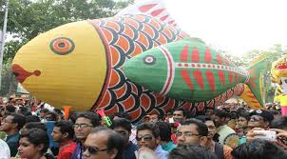
Group Work
All of you, make five sentince about “Pahela Boishakh”.

Slide 14
Learning Assessment
1. Choose the best answer from the alterna
(a) The cultural programme begins with the famous song by-
(i) Kazi Nazrul Islam
(ii) Rabindranath Taqore
(iii) Sunirmal Sen
(iv) Jasim Uddin
(b) When do people wake up on ‘Pahela Boishakh,?
(i) In the midnight
(ii) At dawn
(iii) Early in the morning
(iv) Late in the morning
(c) Who arrange the cultural function at Ramma Batamul on this day ?
(i) Bangla Academy
(ii) Chhyanata
(iii) Dhaka University
(iv) Shilpakala Academy
(d) What kind of dresses do the people put on ?
(i) National dresses
(ii) New dresses
(iii) Traditional dresses
(iv) Costlyl dresses

Slide 15
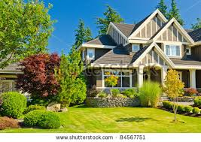
HOME WORK
Write a short Paragraph about ‘Pahela Bishakh’.

Slide 16
Thanks all

